Slide 1


Groningen Municipality Crime Data 1996-2021
Evalution of crime data, corelation and fitting a LSTM model for predictions.
Alex de Vries, Feb 2023

Slide 2
Introduction
A presentation targeted at stakeholders
A presentation targeted at data science peers

Slide 3
a presentation targeted at stakeholders
Presentation 1

Slide 4
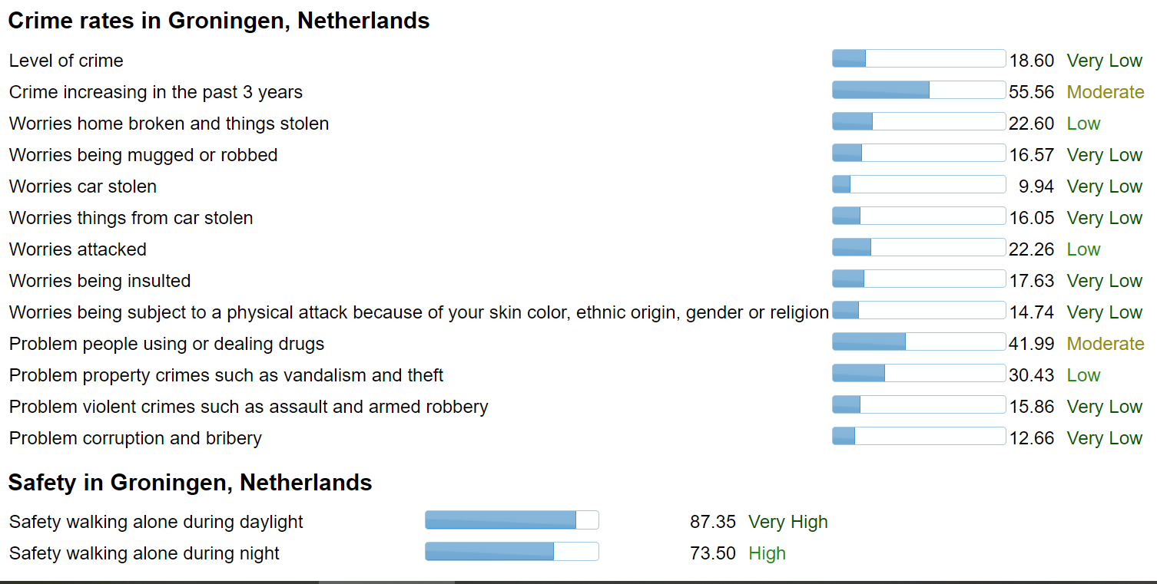
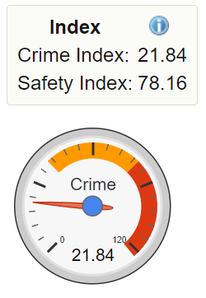
The use case
Presentation 1
Is the crime rate going down or up over time?
https://www.numbeo.com/crime/in/Groningen

Slide 5
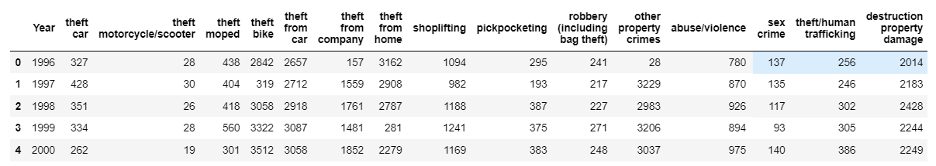
The data set
Presentation 1
Crime data for the municipality of Groningen from 1996 - 2021.
It is broken down by crime type. The crime type and subtypes are available both in
Dutch and in English. English translations done by Google translate.
https://www.kaggle.com/datasets/megan3/groningen-crime-data-19962021

Slide 6
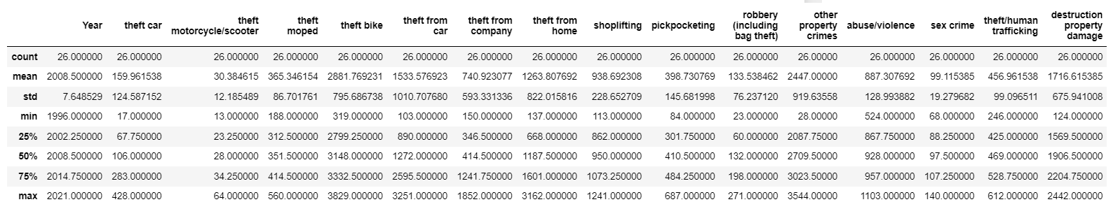
The data set
Presentation 1
No missing values. 26 years of data for all features.
https://www.kaggle.com/datasets/megan3/groningen-crime-data-19962021

Slide 7
the solution to the use case
Presentation 1
Step 1: normalize each feature
Step 2: store the combined mean of all features for each year in a new feature
Step 3: Use this new feature as the indication of overal crime rate
Step 4: Apply LSTM on this non-linear time data.

Slide 8
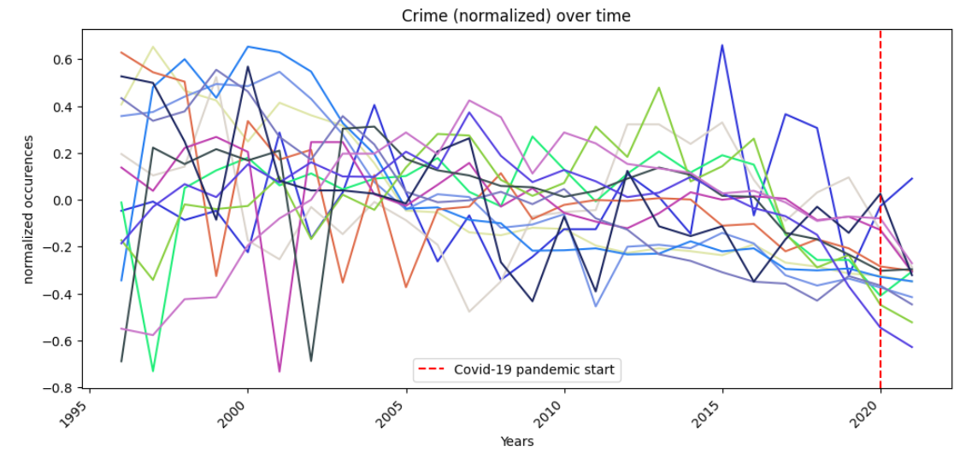
the solution to the use case
Presentation 1
Figure 1: plot all crime features over time. Seems to go down over time, but unclear.

Slide 9
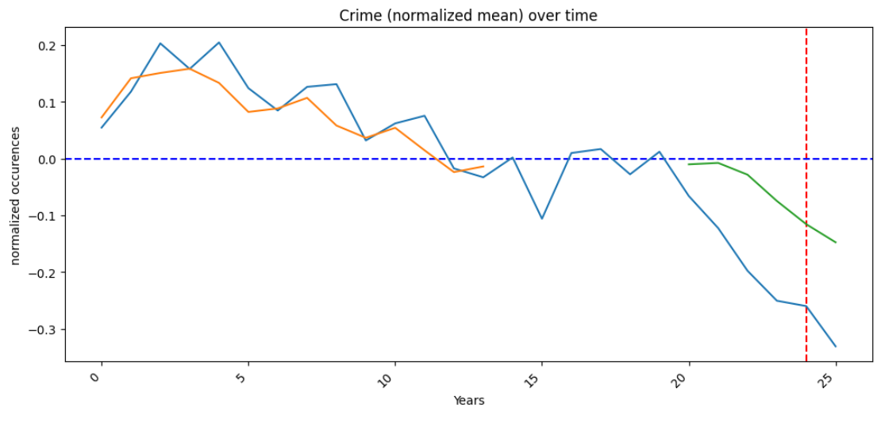
the solution to the use case
Presentation 1
Figure 2: Blue line is the normalized mean crime rate. Below 0 indicates a reduction.
Orange line is the training data set, Green the test dataset. Clearly crime rate goes
Down over time.

Slide 10
summary
Presentation 1
Keeping it simple for stakeholders
Crime goes down over time.
The decrease is accelarating.
The LSTM is predicting well, but can be improved with more data.

Slide 11
A presentation targeted at data science peers
Presentation 2

Slide 12
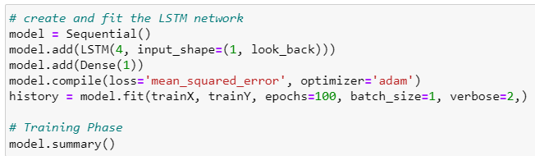
architectural choices
Presentation 2
Why LSTM modelling
LSTM networks are well-suited to classifying, processing and making predictions based on time series data, since there can be lags of unknown duration between important events in a time series.

Slide 13
data quality assessment
Presentation 2
data pre-processing & feature engineering
Check for null values -> none
Transpose data
Create year column
Normalize each feature
New feature -> mean of sum of all normalized features. This will be used as Crime rate indication.

Slide 14
Data set overview
Presentation 2
Figure 3: plot all crime features over time. Seems to go down over time, but unclear.

Slide 15
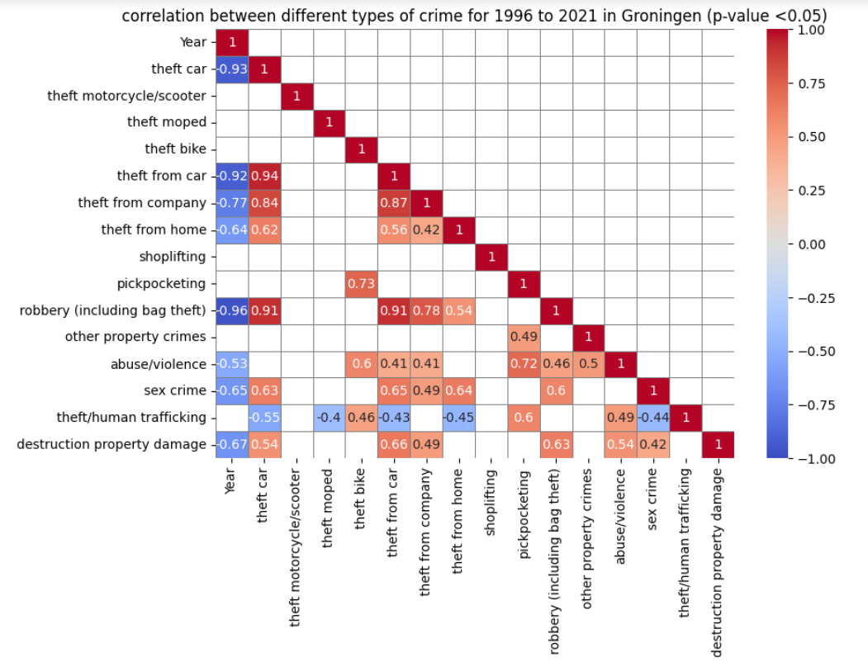
Data set overview
Presentation 2

Slide 16
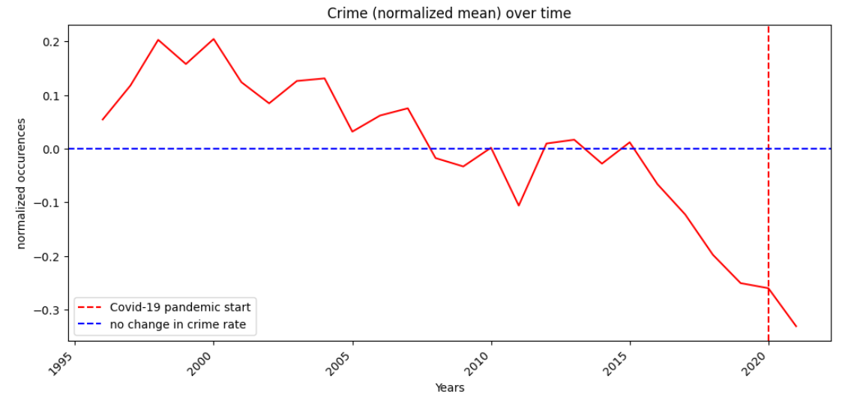
Data set overview
Presentation 2

Slide 17
Data set overview
Presentation 2

Slide 18
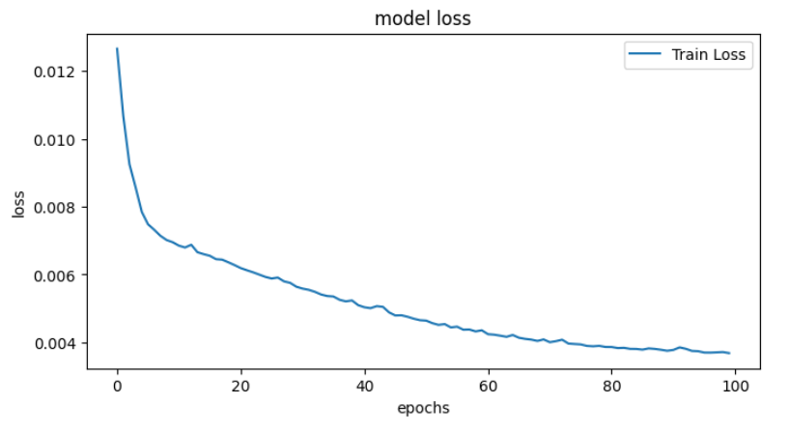
model performance indicators
Presentation 2

Slide 19
summary
Presentation 1
Crime goes down over time.
The decrease is accelarating.
The LSTM is predicting well, but can be improved with more data.
Multiple feature are correlated.

